Slide 1

Internet Health Report
Romain Fontugne
IIJ Research Lab
2023-01-26

Slide 2



IHR vision
An observatory for the Internet
Monitor & document Internet topology, evolution, and sudden changes
Open data / open source

Slide 3
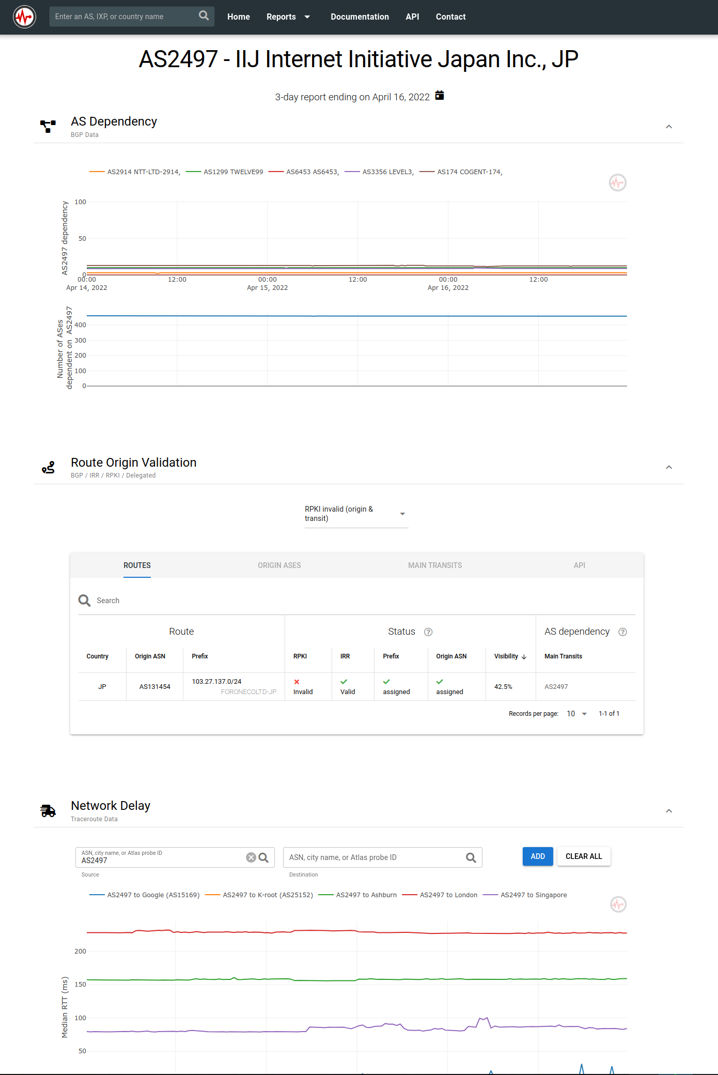














Monitoring the Internet
Open data
- BGP - traceroute - RPKI
Analysis modules
- Network dependency
- Network latency - Disconnections - Anomaly detection
Outcomes - https://ihr.iijlab.net
- Visualization
- API
- Daily dumps
- External collaborations / tools

Slide 4
Network dependency (AS Hegemony)
AS4
Measure AS inter-dependencies
Using BGP data
Give a good idea of the 'topological location' of ASes
Customers of an AS
Example: https://ihr.iijlab.net/ihr/en-us/networks/AS2501
AS3
AS2
AS1

Slide 5
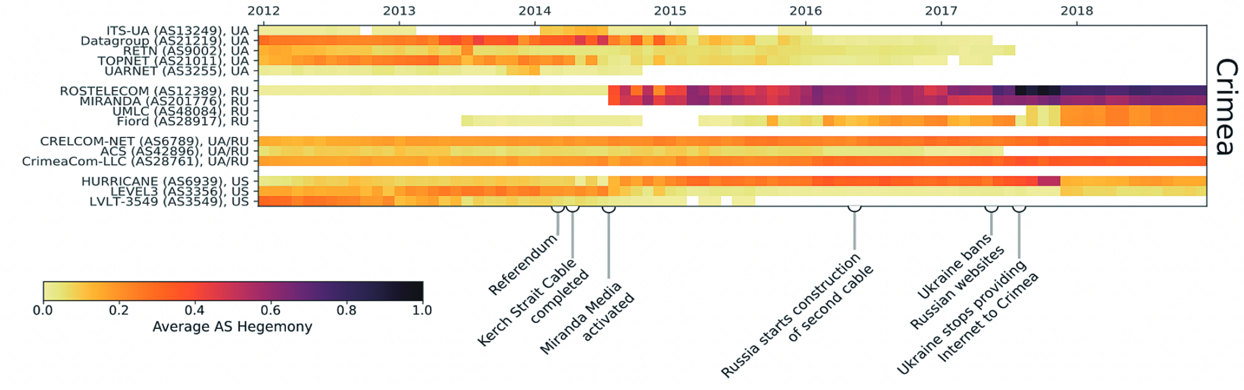
Network dependency variants
Regional bottleneck (e.g. Crimea)
Countries' AS dependency:
https://ihr.iijlab.net/ihr/en-us/countries/JP
BGP leak/hijacks, routing anomalies, AS ranking, consolidation, bottlenecks, peering
Rogers outage: https://twitter.com/ihr_alerts/status/1545789981603823616

Slide 6
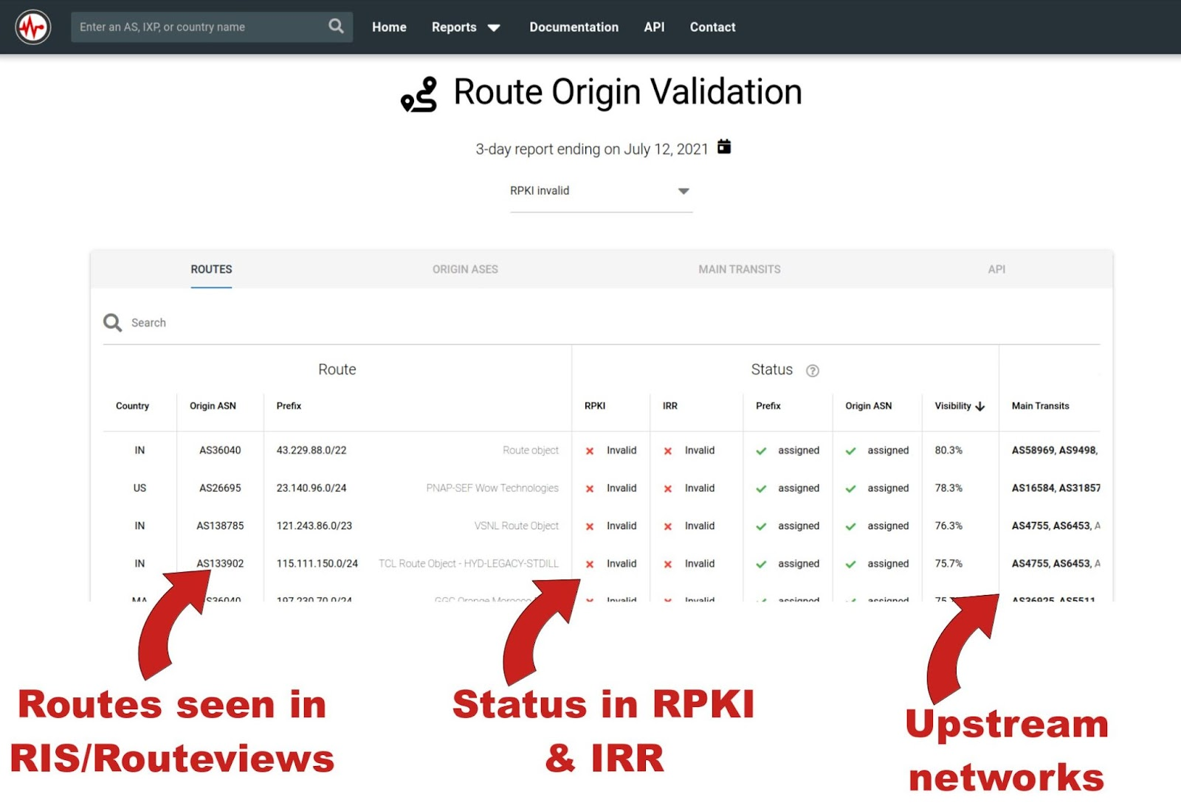
RPKI
Convey operators' intent
Trust (Public Key Infra.)
Route Origin Authorization (ROA)
AS15169 is authorized to announce 8.8.8.0/24
IHR monitors operators' intentions (RPKI) and actions (BGP)
Global view: https://ihr.iijlab.net/ihr/en-us/rov
Country-wide view: https://ihr.iijlab.net/ihr/en-us/countries/JP
Per AS: https://ihr.iijlab.net/ihr/en-us/networks/AS22822

Slide 7
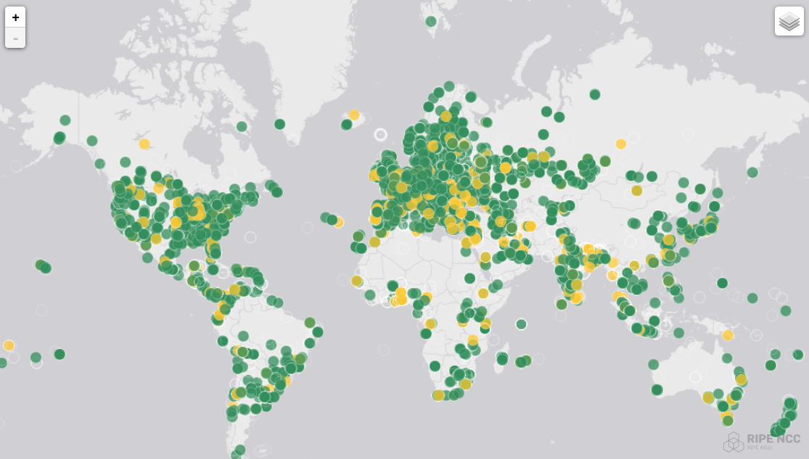
Network delays
RIPE Atlas (12k probes) Tons of traceroutes to several destinations
IHR monitors latency between Atlas probes and ASes/IXPs/cities/countries found in traceroutes
Examples:
Impact of subsea cable cut: https://twitter.com/DougMadory/status/1447659550975406094
Impact of COVID lockdowns: https://ihr.iijlab.net/ihr/en-us/covid19?country=France
War in Ukraine: https://twitter.com/ihr_alerts/status/1501446740498841604

Slide 8
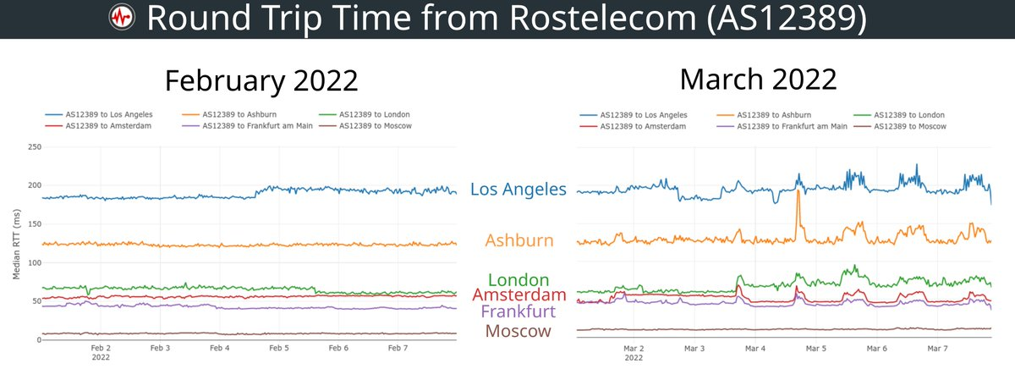
Network congestion

Slide 9
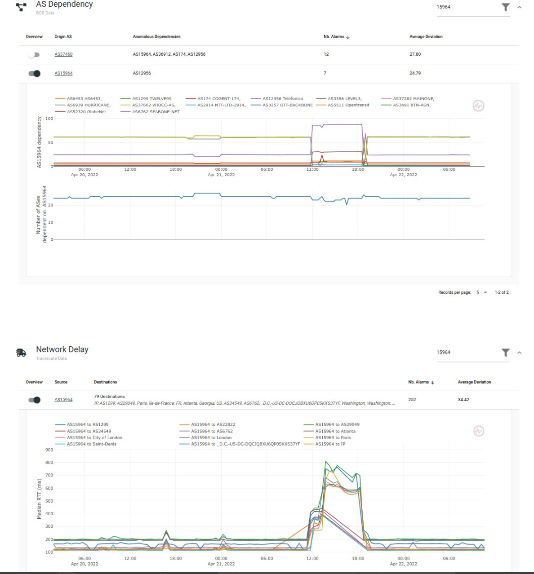
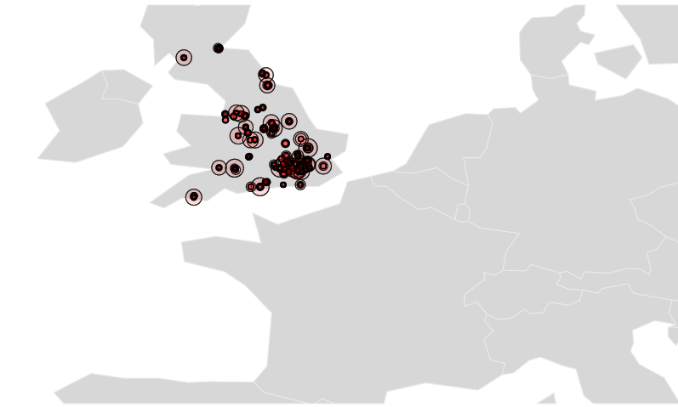
IHR Anomaly detectors
Disco
Outage detection
Based on RIPE Atlas
Virgin Media outage
Route, delay changes
Global report

Slide 10
Internet Yellow Pages
Knowledge graph for networking data
12 data sources:
APNIC, BGPKIT, Bgp.tools, CAIDA, Cloudflare, IHR, MANRS, OpenINTEL, PeeringDB, RIPE NCC, NRO, Tranco
Semantic: 17 node types, 21 link types
About 4M nodes, 15M links

Slide 11
References
IHR: http://ihr.live
Github: https://github.com/InternetHealthReport
IHR daily dumps: https://ihr-archive.iijlab.net
Yellow Pages: https://github.com/InternetHealthReport/internet-yellow-pages/
romain@iij.ad.jp @ihr_alerts

